Slide 1


Slide 2
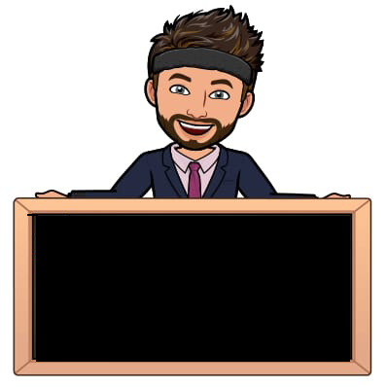
INTRODUCTION TO
COMMUNICATION
SKILLS

Slide 3
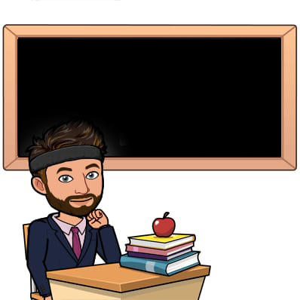
Verbal Communication
Non-Verbal Communication
Para-Verbal Communication,
Barriers to Communication
Techniques and Tips to Improve Communication
How to strike a Social Conversation
Lovely professional university

Slide 4

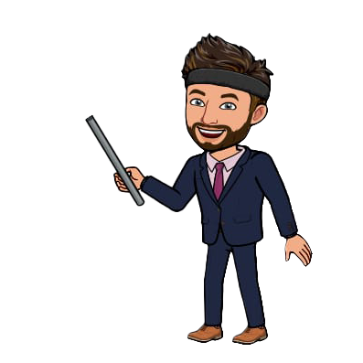
Introduction to Communication Skills
  Communication is the cornerstone of human interaction.
  Effective communication skills are essential for success in various aspects of life, including personal relationships, work, and public speaking.
  It involves the exchange of information, ideas, thoughts, and emotions between individuals.

Slide 5
Verbal Communication
Elements of verbal communication:
Vocabulary: Choice of words and language proficiency.
Verbal communication involves the use of words, spoken or written, to convey messages.
Tone: The way words are spoken, which can indicate emotion or intent.
Clarity: Ensuring messages are easily understood by using concise and appropriate language.
Listening: An important component of effective verbal communication.

Slide 6
Non-Verbal Communication
Types of non-verbal communication:
Body Language: Gestures, facial expressions, posture, and eye contact.
Non-verbal communication is the transmission of information without using words.
Proxemics: Use of personal space to convey comfort, authority, or intimacy.
Touch: Conveys emotions, comfort, or connection.
Appearance: Clothing, grooming, and personal style.
Visual Symbols: Signs, symbols, and visual cues.

Slide 7
Paraverbal Communication
Paraverbal communication refers to how something is said rather than the actual words used.
Elements of paraverbal communication:
Pitch: High or low tone of voice.
Pace: Speed at which speech is delivered.
Volume: Loudness or softness of speech.
Intonation: Patterns of pitch and tone that add meaning to words.
Pauses: Strategic pauses for emphasis or clarification.

Slide 8
Language Barriers
Psychological Barriers
Cultural Barriers
Organizational Barriers
Physical Barriers
Barriers to Communication
Different Dialects & Taboos
Stress, Anxiety, Anger
Customs, Norms, Beliefs, Traditions
Hierarchy, Rules, Policies, Structure
Distance, Mode, Noise, Technology

Slide 9
Empathy
Simplify Language
Cultural Sensitivity
Cooperation
Feedback
Overcoming Communication Barriers
Ability to understand and share the feelings of another
Avoiding complex linguistic skills
Accepting and following cultural beliefs
Positive listening and speaking practices
Sharing response and appreciation

Slide 10
ACCOUNTING FOR LOSSES AND GAINS IN PROCESS COSTING
NORMAL LOSS
ABNORMAL LOSS
ABNORMAL GAIN
THAT’S A WRAP
THANK YOU

